Slide 1


Data Analyst Remote Task
Francisco Florido Valero

Slide 2
Data Preparation Steps
Data preprocesing
Data normalization
Data integration

Slide 3
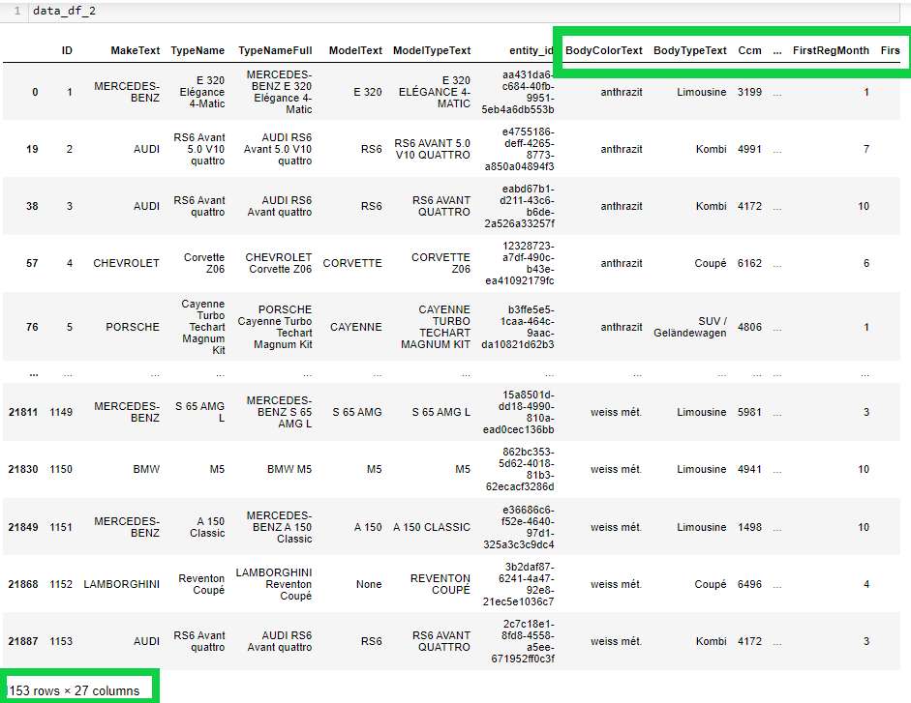
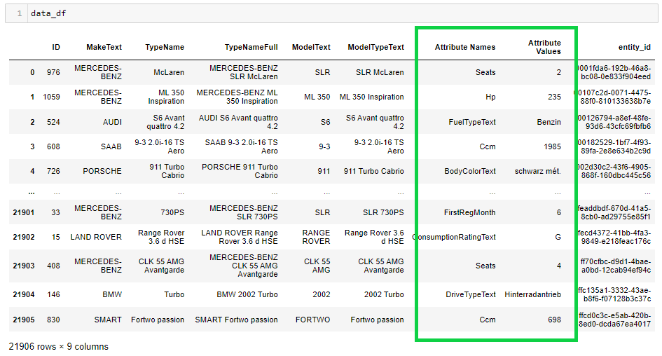
Data Pre-procesing
Goal: Transform the supplier data to achieve the same granularity as the target data
Step 1: Unpivot values in “Attribute Name” column to different attribute columns.

Slide 4
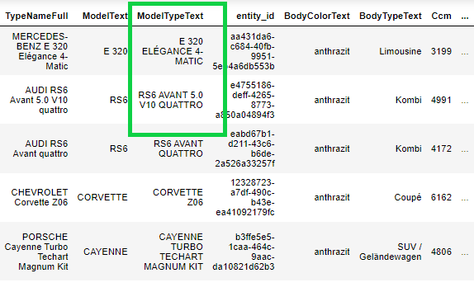
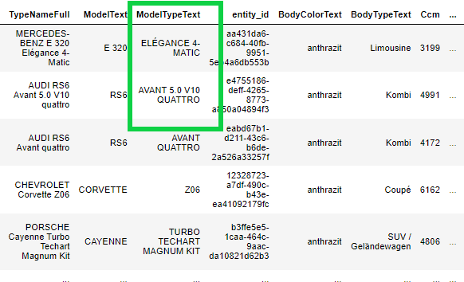
Data Pre-procesing
Step 2: Retrieving attributes that can be obtained out of existing columns.
- model_variant column:

Slide 5
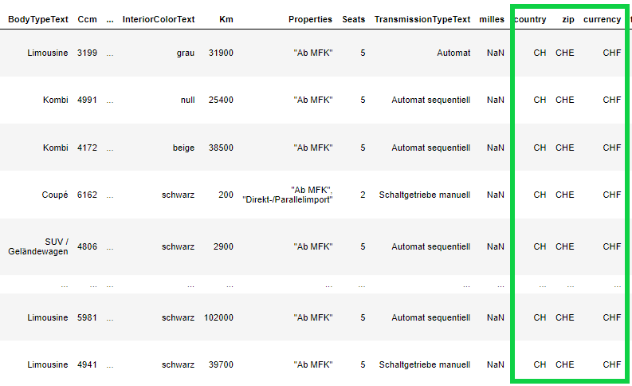
Data Pre-procesing
Step 2: Retrieving attributes that can be obtained out of existing columns.
- Country, zip and currency column:

Slide 6
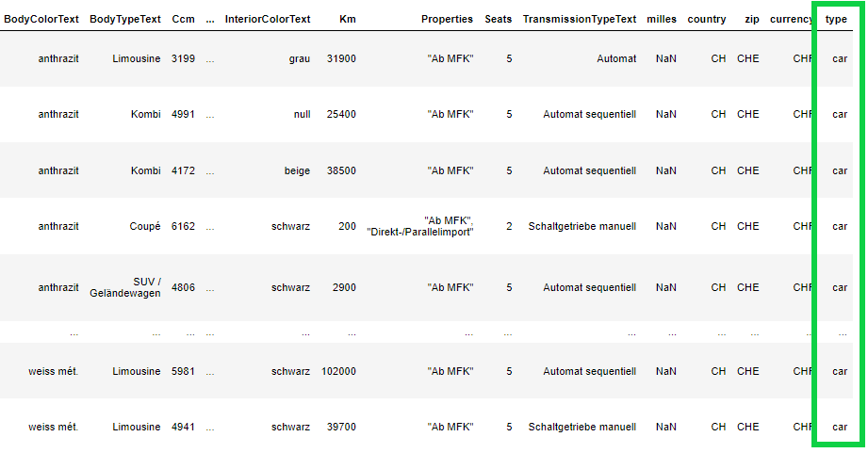
Data Pre-procesing
Step 2: Retrieving attributes that can be obtained out of existing columns.
- Type column:

Slide 7
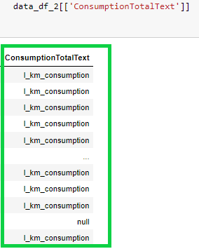
Data Pre-procesing
Step 2: Retrieving attributes that can be obtained out of existing columns.
- Fuel Consumption unit column :

Slide 8
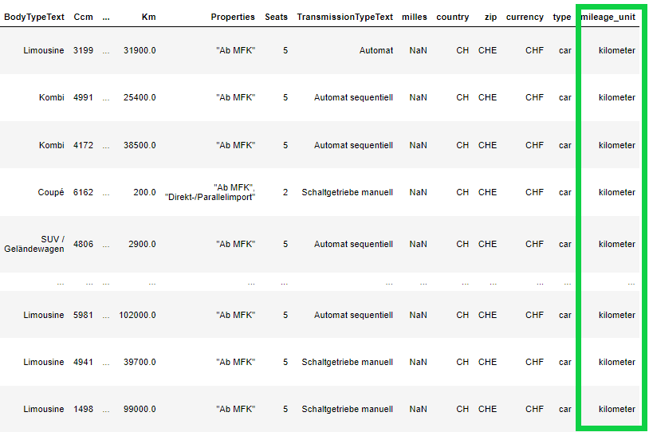
Data Pre-procesing
Step 3: Differentiate between Kilometer and miles.

Slide 9

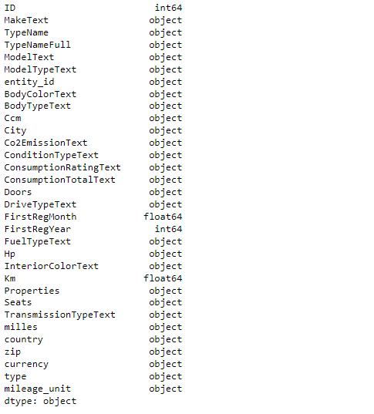
Data Preprocesing
Step 4: Change the type of some of the columns to match target data.

Slide 10
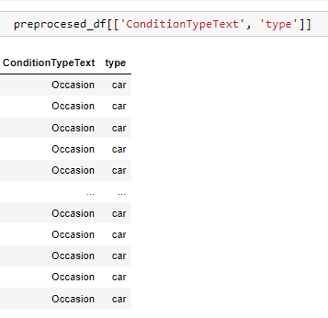
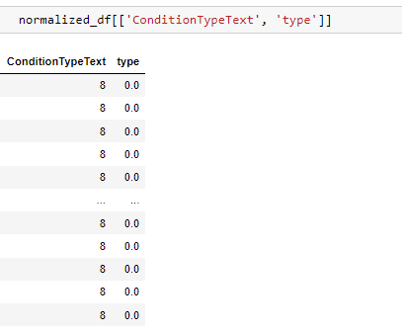
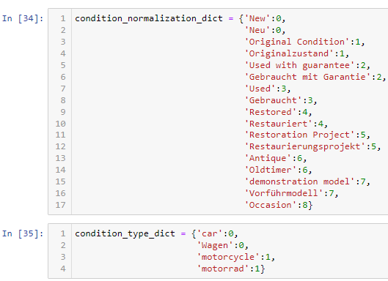
Data Normalization
Goal: Normalize columns that can cause duplicated ways of referring to the same attribute.
“Condition” and “type” normalization.

Slide 11
Data Normalization
Other normalizations suggested.
Price_on_request: This column needs to be normalized ([False:0,True:1]).
Country: Has to be normalized using country dictionary to avoid diferente classifications for the same attribute.
carType: Normalization needed to avoid diferente classifications for the same attribute.

Slide 12
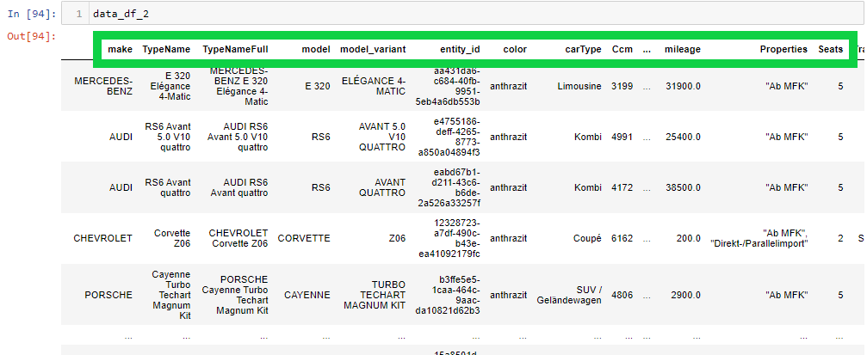
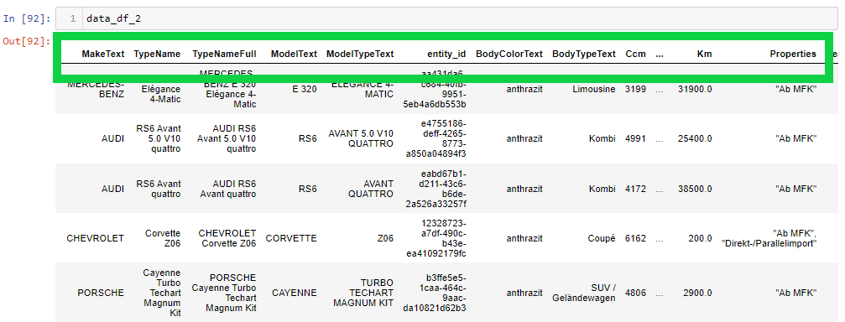
Data Integration
Goal: Transform supplier´s data with a specific data scheme into a new dataset with target data scheme.
Step 1: Rename columns to match target DataFrame.

Slide 13
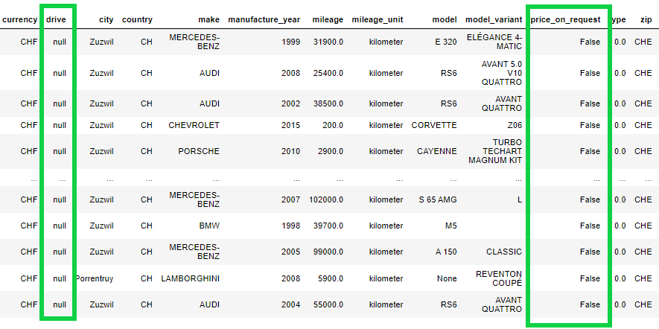
Data Integration
Step 2: Add null columns that appear in target DataFrame but are not present.

Slide 14
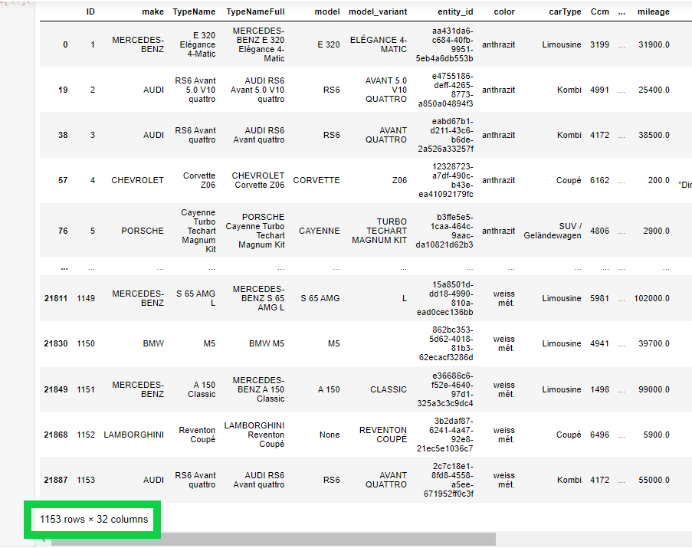
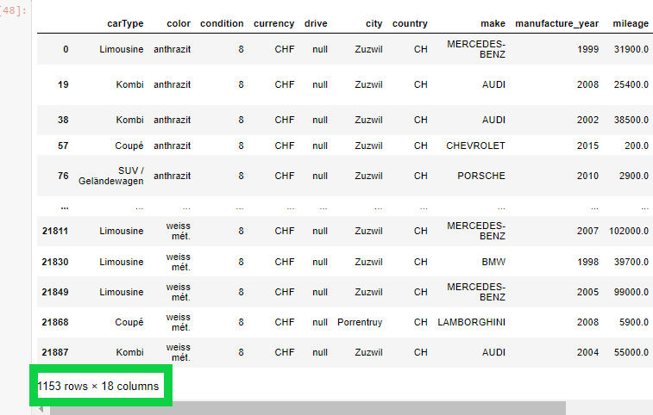
Data Integration
Step 3: Keep the columns needed.

Slide 15
Potential improvements to be implemented
Normalize all the columns mentioned in slide 11 instead of just two.
Better definition of the Zip column.
Keep additional columns that don’t appear in target data, if applies. (Interior color, Ccm, transmission type).

Slide 16

Action Points
Suggested actions points for the customer, if applies:
Consider gathering the attribute name currently in a single column data column into separated columns.
Consider gathering the data either in English or German, in case the data is in another language flag it.
Add price_on_request information, if there is no data set to null.
Add drive information, if there is no data set to null.

